Slide 1

Sybil Attack & Bot Detection
Utilizing Machine Learning for Effective Solutions
Presenting to: Dr. Mingjun Li
Prsenting by: Noshini Islam Naina

Slide 2
Understanding Sybil and Bot Accounts
Social networks face increasing numbers of automated bot/Sybil accounts
Bots imitate human behavior to bypass detection
Used for misinformation, spam, fraud, fake engagement
Detecting them manually is impossible
Machine learning provides scalable detection

Slide 3

The Impact of Fake Accounts

Slide 4

Bots disrupt trust, communication, and online safety
Influence public opinion and trends
Create fake interactions and engagement
Threaten security in online communities
Need automated, accurate identification
Motivation

Slide 5
Problem Statement
Can we classify accounts as Human or Bot/Sybil using behavioral features?
Evaluate model performance across multiple algorithms
Analyze which model performs best and why
Build ML models to detect suspicious activity patterns

Slide 6
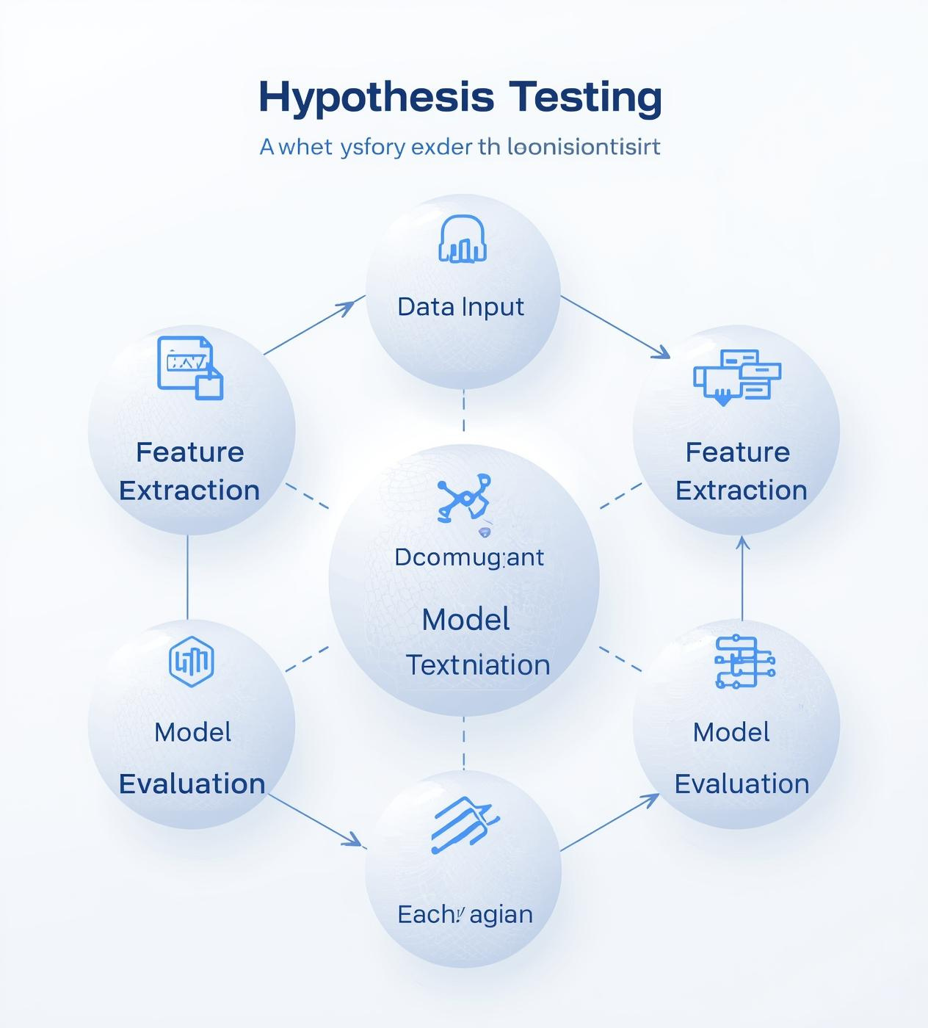
Bot Detection
Behavioral features effectively differentiate bots from humans.
Stability Improvement
The 71-block transformation enhances learning consistency and stability.
Dataset Validity
Dataset labels are assumed to be accurate and reliable.

Slide 7

Dataset Overview
Analysis of 50,000 Twitter accounts for bot detection and behavior understanding
50,000 accounts
Features: tweet, retweets, mentions, followers, verified status, hashtags
Bot label: 0 (human) or 1 (bot)

Slide 8

Essential steps for preparing data for machine learning models
Encode Verified
Encode Bot Label
Tweet Length
Hashtag Count
StandardScaler

Slide 9
Feature Engineering
Added Tweet Length (number of characters)
Added Hashtag Count (number of hashtags used)
Reason:
Bots often use template-style tweets
Frequent hashtag patterns repeat
Useful to differentiate human vs bot behavior

Slide 10
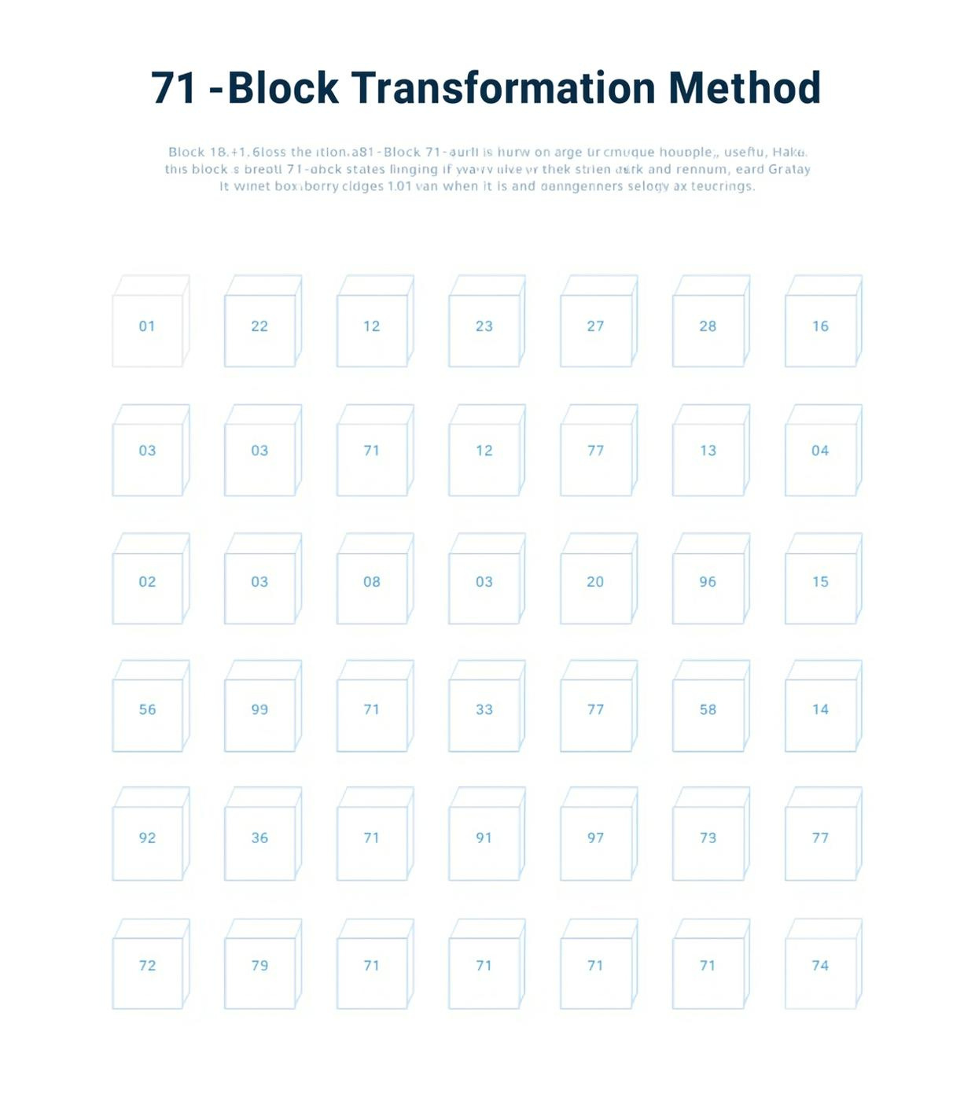
71-Block Method
Enhancing data stability and representation through structural transformation techniques
Dataset row indices split into 71 groups
Example: Block 0 → rows 0, 71, 142, …
Each block appended with feature Xi = number of features
Provides even distribution across groups
Reduces model overfitting on ordering
Improves data structure consistency for ML

Slide 11
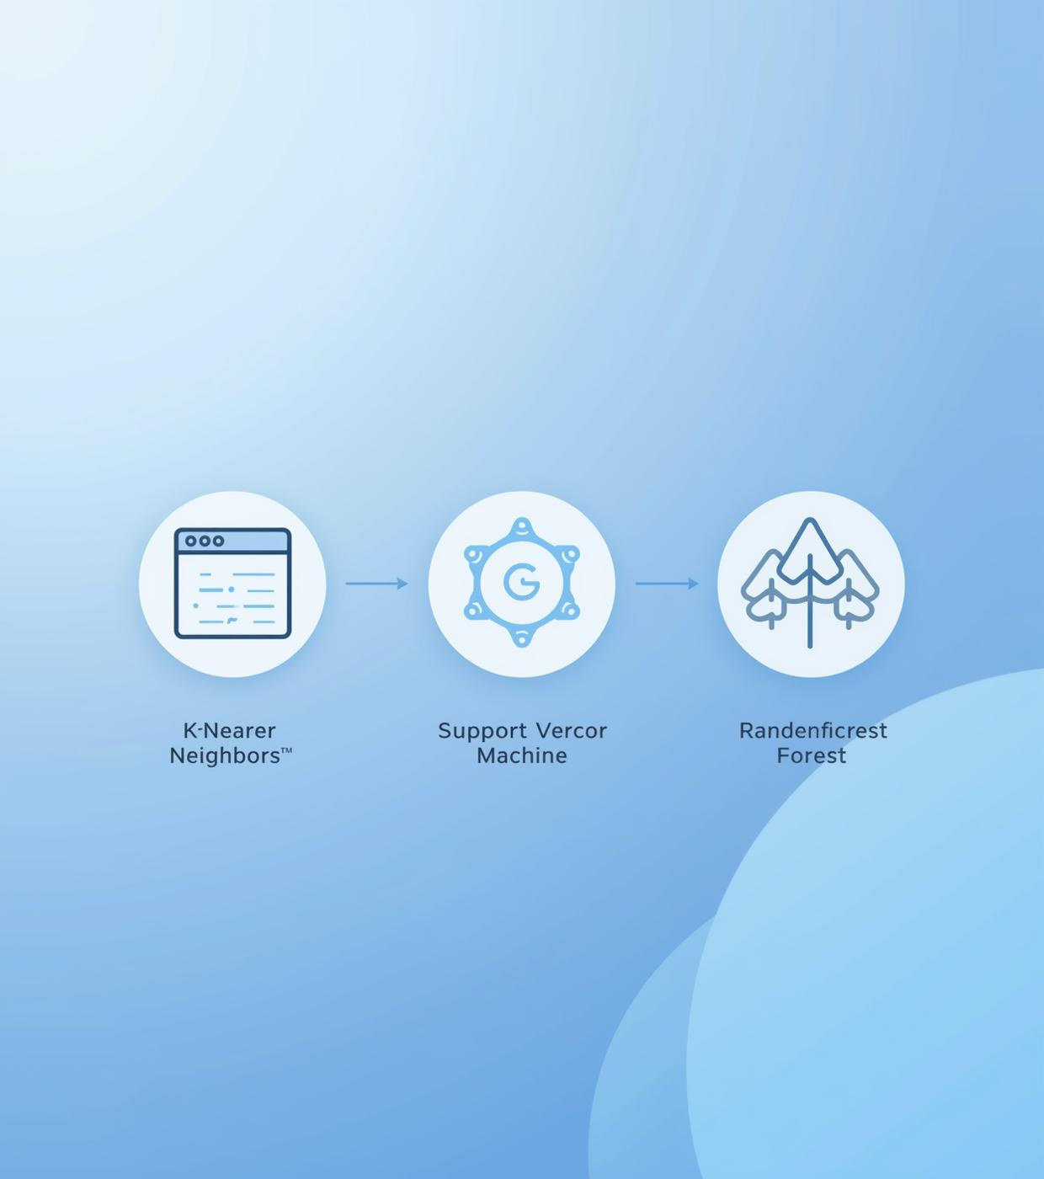
Machine Learning Models
Overview of techniques used for detecting Sybil accounts effectively
KNN for distance-based classification
SVM utilizes RBF kernel for non-linear data
Random Forest for ensemble learning
Stratified sampling ensures balanced training sets

Slide 12
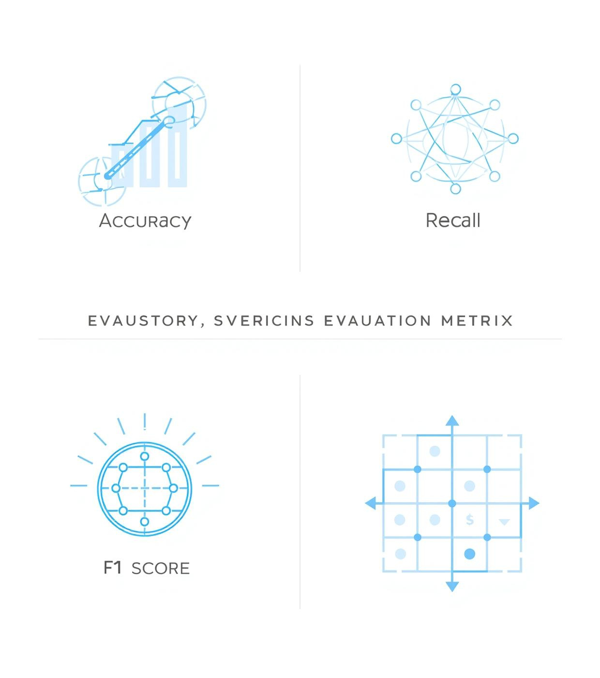
Evaluation Metrics
Key performance indicators for assessing model effectiveness in detecting bots
Accuracy measures overall correctness
Precision gauges true positive rate
Recall assesses sensitivity to true positives
F1 score balances precision and recall

Slide 13
Model Comparison
Model | Accuracy | Precision | Recall | F1-Score | Strengths | Weaknesses
KNN | 0.4953 | 0.4957 | 0.4948 | 0.4952 | Simple, fast, stable | Performs like random guessing; sensitive to feature scaling
SVM (RBF) | 0.5028 (Best) | 0.5039 | 0.4115 | 0.4530 | Best accuracy; handles non-linear patterns | Recall very low; struggles with subtle feature differences
Random Forest | 0.4982 | 0.4986 | 0.4948 | 0.4967 | Balanced predictions; low overfitting | No real improvement; features too simple for tree splits

Slide 14
Best Model: SVM (RBF Kernel)
Why SVM performs best:
Can model non-linear decision boundaries.
Works well with standardized numeric features.
Slight advantage with limited feature sets.

Slide 15
Limitations
Only behavioral numeric features used
No text-based features (tweet content)
No temporal features (posting patterns)
No social graph features (network links)
71-block reduces dataset granularity

Slide 16
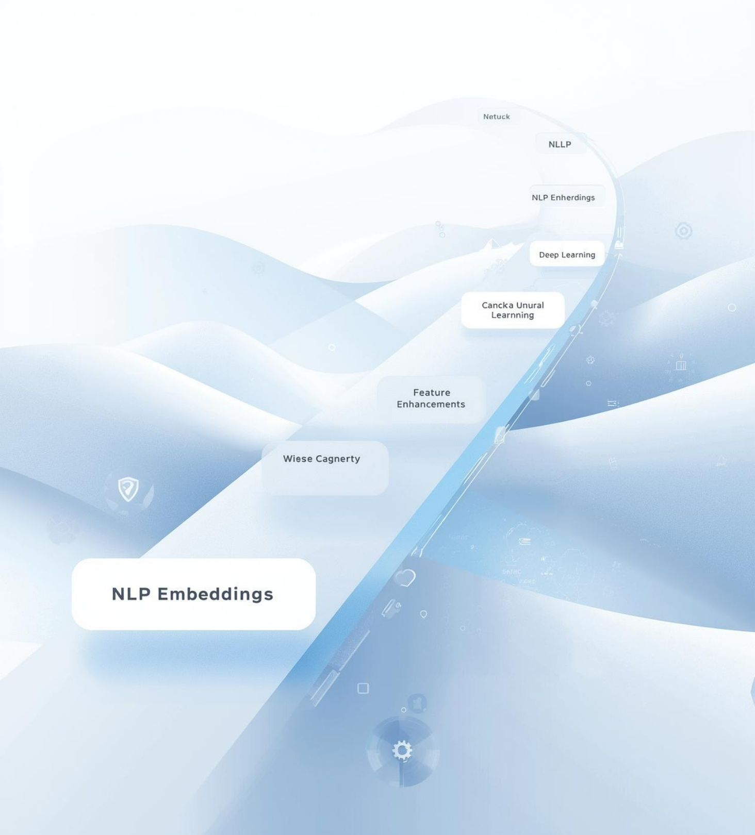
Enhancements and Next Steps
Add NLP features (BERT embeddings, TF-IDF)
Add graph features (follower network structure)
Add time-series features (posting frequency)
Use deep learning models
Explore ensemble boosting (XGBoost, LightGBM)
Collect richer real-world dataset

Slide 17
Conclusions
Built a complete ML pipeline for Sybil/Bot detection
Applied preprocessing, feature engineering, 71-block structuring
Compared 3 ML models with balanced dataset
SVM showed best performance (~50%)
Future feature enhancements can significantly improve accuracy

Slide 18
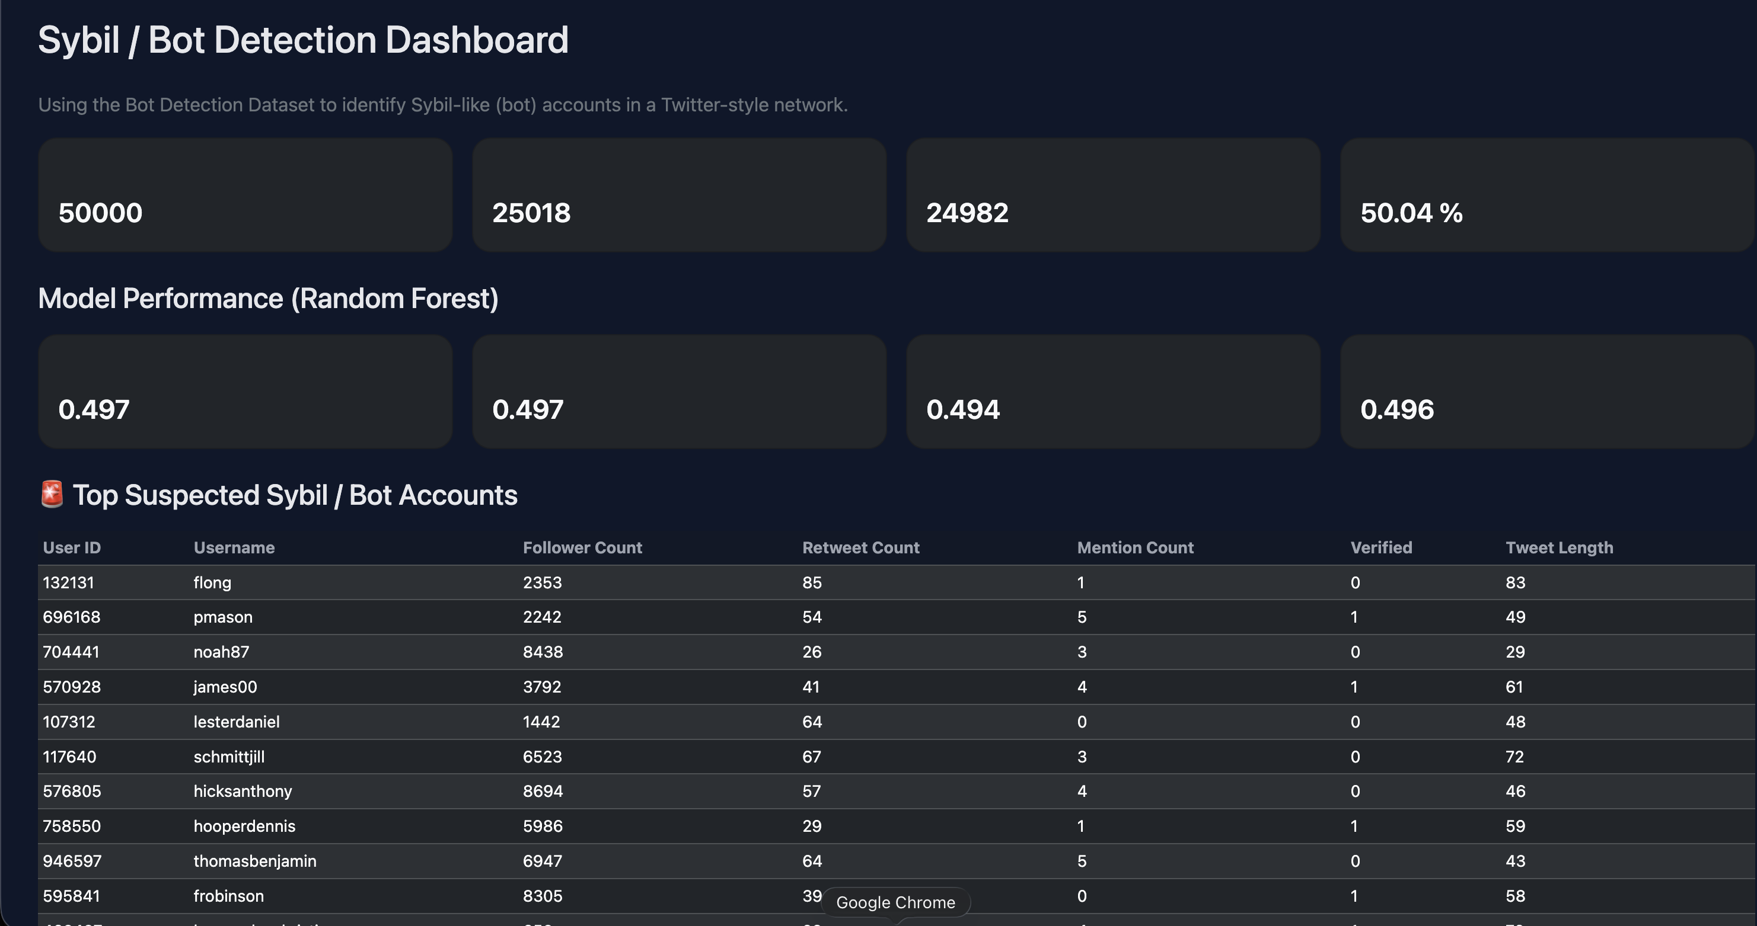
Dashboard Overview

Slide 19
Thank You

